Slide 1
DATA PERSISTENCE USING ENTITY FRAMEWORK CORE
In ASP.NET Core MVC

Slide 2
The IActionresult type
The IActionResult Type is generally the default return type within scaffolded ASP.NET Core code – as it supports returning any of the concrete ActionResult class subtypes available within ASP.NET Core.
Methods can (and should) be left as IActionResult when it is possible to have multiple ActionResult sub-types returned from a Controller Action (or you are not certain which may be returned yet)

Slide 3
Available actionresult types for controller actions
Microsoft.AspNetCore.Mvc.ChallengeResult
Microsoft.AspNetCore.Mvc.ContentResult
Microsoft.AspNetCore.Mvc.EmptyResult
Microsoft.AspNetCore.Mvc.FileResult
Microsoft.AspNetCore.Mvc.ForbidResult
Microsoft.AspNetCore.Mvc.JsonResult
Microsoft.AspNetCore.Mvc.LocalRedirectResult
Microsoft.AspNetCore.Mvc.ObjectResult
Microsoft.AspNetCore.Mvc.PartialViewResult
Microsoft.AspNetCore.Mvc.RazorPages.PageResult
Microsoft.AspNetCore.Mvc.RedirectResult
Microsoft.AspNetCore.Mvc.RedirectToActionResult
Microsoft.AspNetCore.Mvc.RedirectToPageResult
Microsoft.AspNetCore.Mvc.RedirectToRouteResult
Microsoft.AspNetCore.Mvc.SignInResult
Microsoft.AspNetCore.Mvc.SignOutResult
Microsoft.AspNetCore.Mvc.StatusCodeResult
Microsoft.AspNetCore.Mvc.ViewComponentResult
Microsoft.AspNetCore.Mvc.ViewResult
REFERENCE URL : ActionResult Class and Subtypes

Slide 4
Notable ActionResult Subtypes
  ViewResult - Renders a specified view to the response stream
  PartialViewResult - Renders a specified partial view to the response stream
  EmptyResult - An empty response is returned
  RedirectResult - Performs an HTTP redirection to a specified URL
  RedirectToRouteResult - Performs an HTTP redirection to a URL that is determined by the routing engine, based on given route data
  JsonResult - Serializes a given ViewData object to JSON format
  JavaScriptResult - Returns a piece of JavaScript code that can be executed on the client
  ContentResult - Writes content to the response stream without requiring a view
  FileContentResult - Returns a file to the client
  FileStreamResult - Returns a file to the client, which is provided by a Stream
  FilePathResult - Returns a file to the client

Slide 5
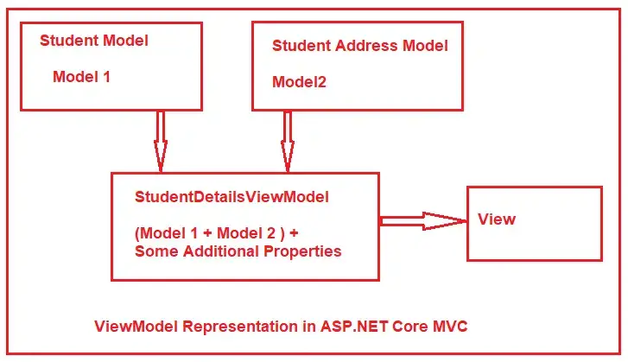
Models vs viewmodels
We have previously created model(s) that do not map to a DB / Tables
As previously discussed, models can act as wrappers for database objects (but they don’t have to)
When we create a model whose purpose is to work with a strongly typed view, passing data and validating it etc...but NOT working directly with a database we call this a ‘View Model’
The Learning Activity for this module will be using a full DB-integrated Model

Slide 6
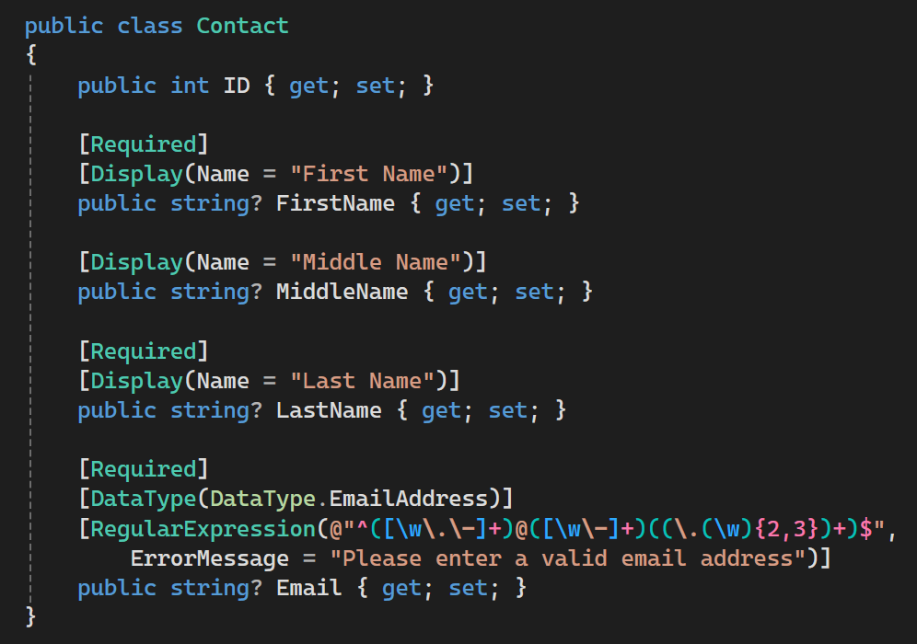
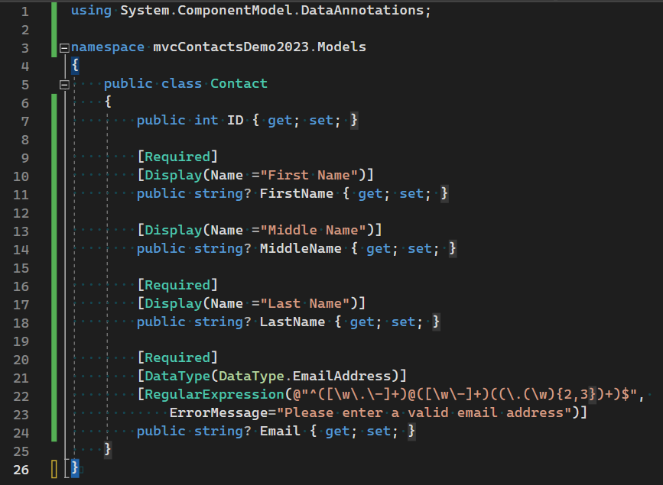
Create a new Model class

Slide 7
The entity framework
Our path forward for data-centric development

Slide 8
Introduction to the Entity Framework
The Entity Framework Core (EF Core) is one of components available within .NET and allows us to access a database using strongly typed code (with C#, F# and Visual Basic)
When leveraging classes that are integrated to use EF Core, you don’t have to worry about the Low-Level abstractions of Data Management:
  No managing SQLConnections, SQLCommands, SQLParameters, DataSets, etc.
  We will work directly with C# code and utilize LINQ
  LINQ (Language INtegrated Query : pronounced "link") is another Microsoft .NET component that adds native data querying capabilities to .NET languages and objects.
  We will be using EF Core with the Code First Approach to creating MVC data-centric applications

Slide 9
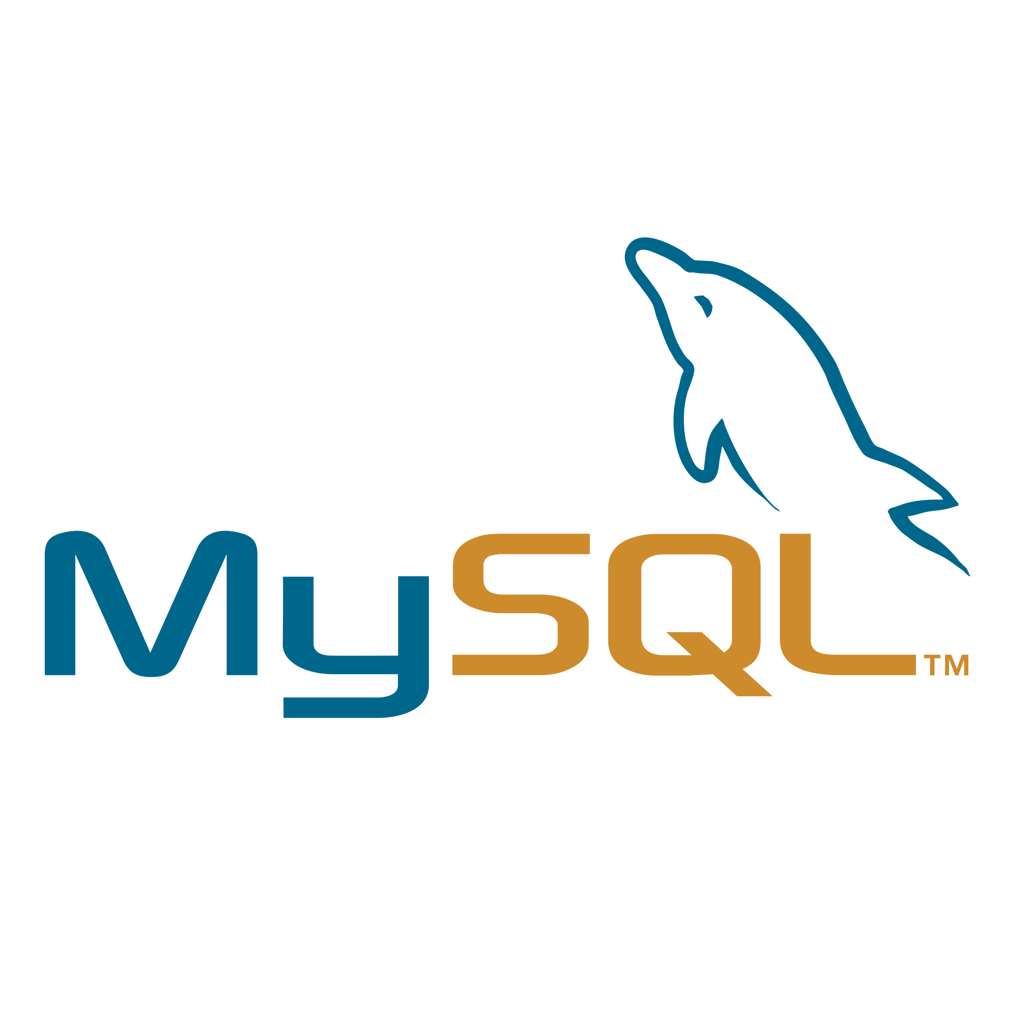

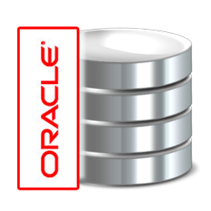

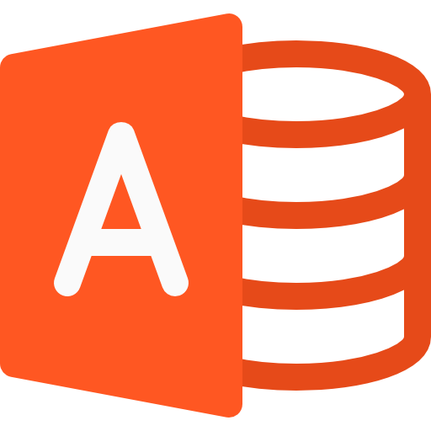
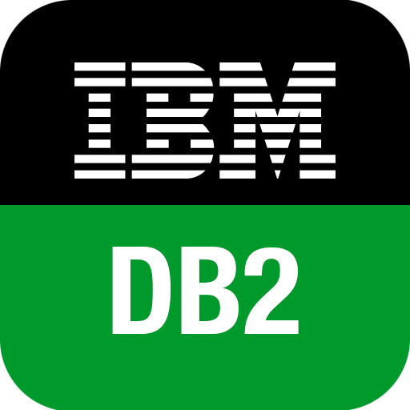





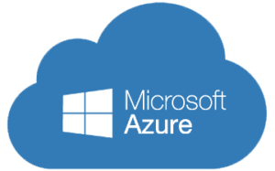
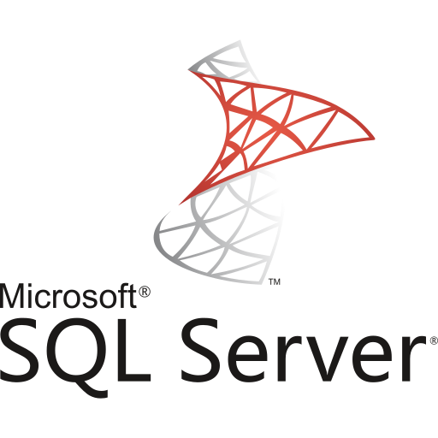
DATABASE SUPPORT FOR EF Core
There is a great amount of support for many popular database platforms, which include:
Microsoft SQL Server
Oracle
IBM DB2
PostgreSQL
and others depicted within this slide

Slide 10

EF Core vs EF 6
Recall that there are 2 different version of ASP.NET contained within .NET:
ASP.NET (from the .NET Framework)
ASP.NET Core (from .NET Core)
There are separate version of the Entity Framework for each:
Entity Framework v6 is a legacy component only meant to be used with ASP.NET (.NET Framework) and legacy applications.
Entity Framework Core is a newer component that is only meant to be used with ASP.NET Core projects, etc.
ONLY USE ENTITY FRAMEWORK CORE

Slide 11
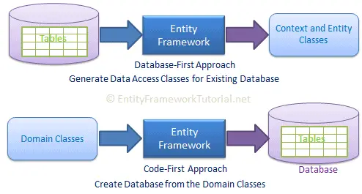
Approaches to using Entity Framework
The EF Core has two different approaches to utilizing it within .NET Applications:
The Database-First Approach
The Code-First Approach

Slide 12
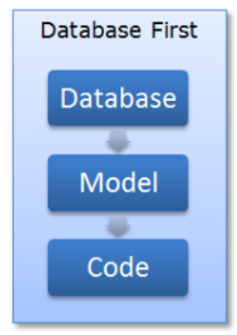
The
Database-First Approach
  (Also known as Schema-First Approach)
  This allows us to leverage an existing database implementation and generate the Model classes and supporting configuration based upon this physical database and the schema.

Slide 13
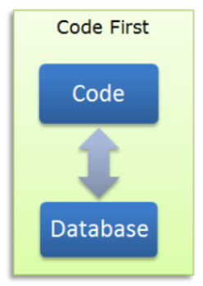
The
Code-First Approach
  In this approach you write your C# model classes first and the EF can generate a DB for use on the fly based upon these class definitions or it can map your classes to an existing DB either using Conventions (Naming Conventions)
  Or using C# code you can provide an explicit mapping from a property on an object to a column that is in a DB table
  The Code First approach is the one that is the most widely embraced by developers and industry
(We will be predominantly using the Code-First Approach)

Slide 14
Installing entity framework core
Welcome to the Nuget Package Manager

Slide 15
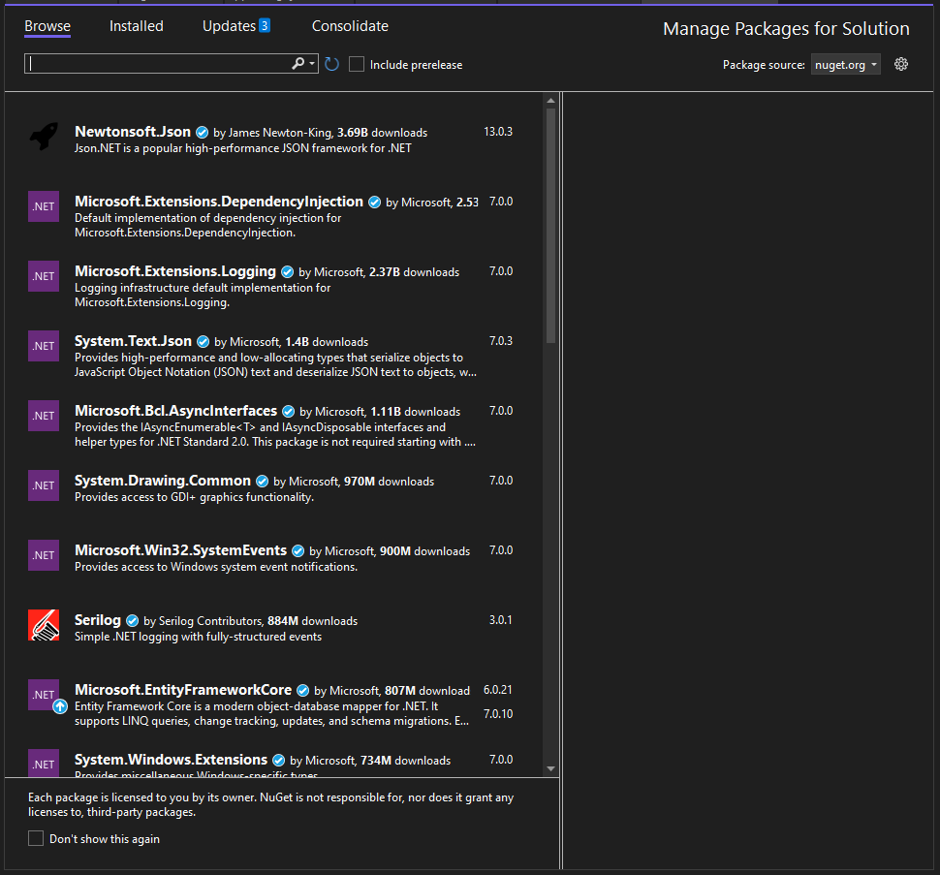
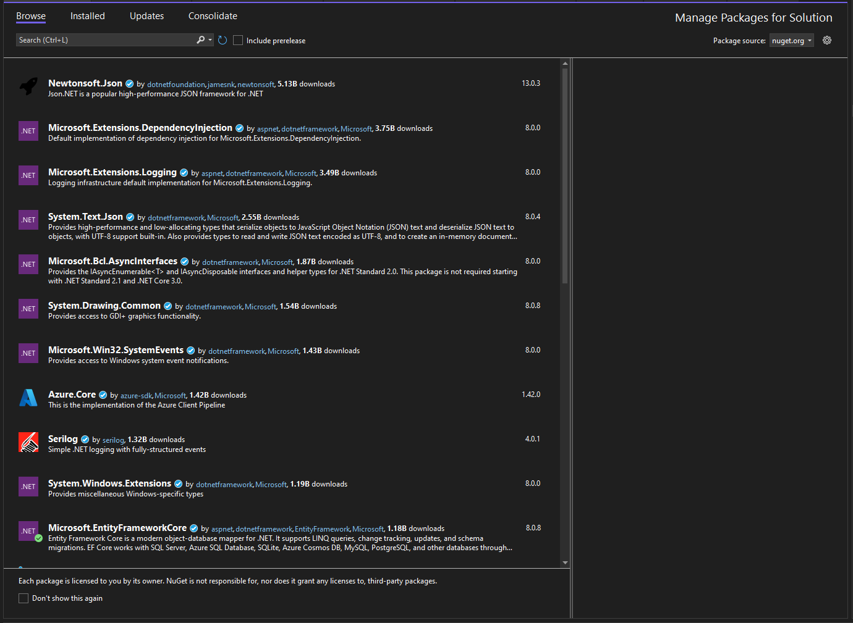
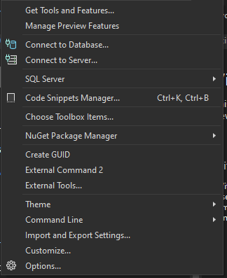

Adding new features to a visual studio project using the nuget package manager
Visual Studio projects come packed with many features right out of the box. However, some features need to be manually added. This is easily accomplished via the NuGet Package Manager, which can be accessed thru the menu options:
Tools ▶ NuGet Package Manager ▶ Manage NuGet Packages for Solution
You will be able to Browse new packages, manage Installed packages, and view outstanding updates for existing packages

Slide 16
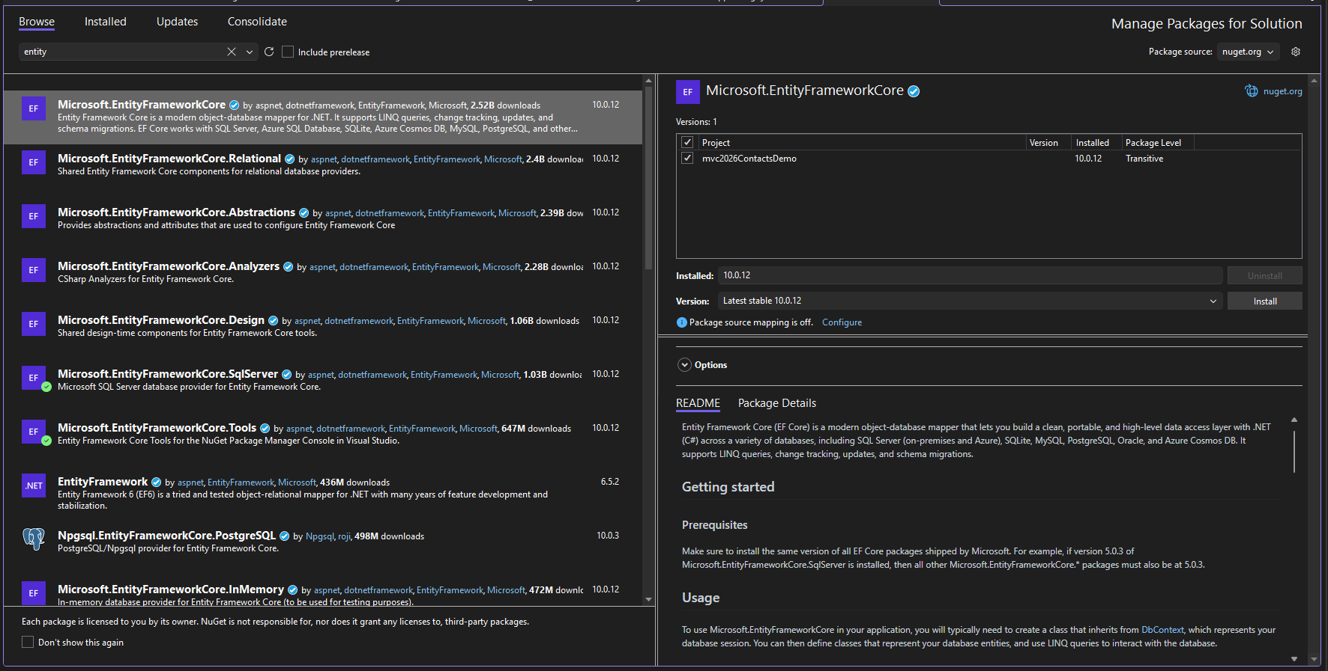
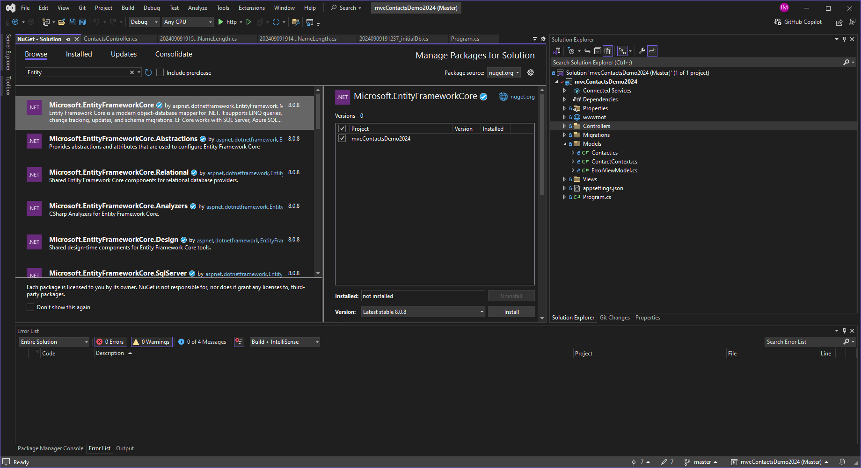
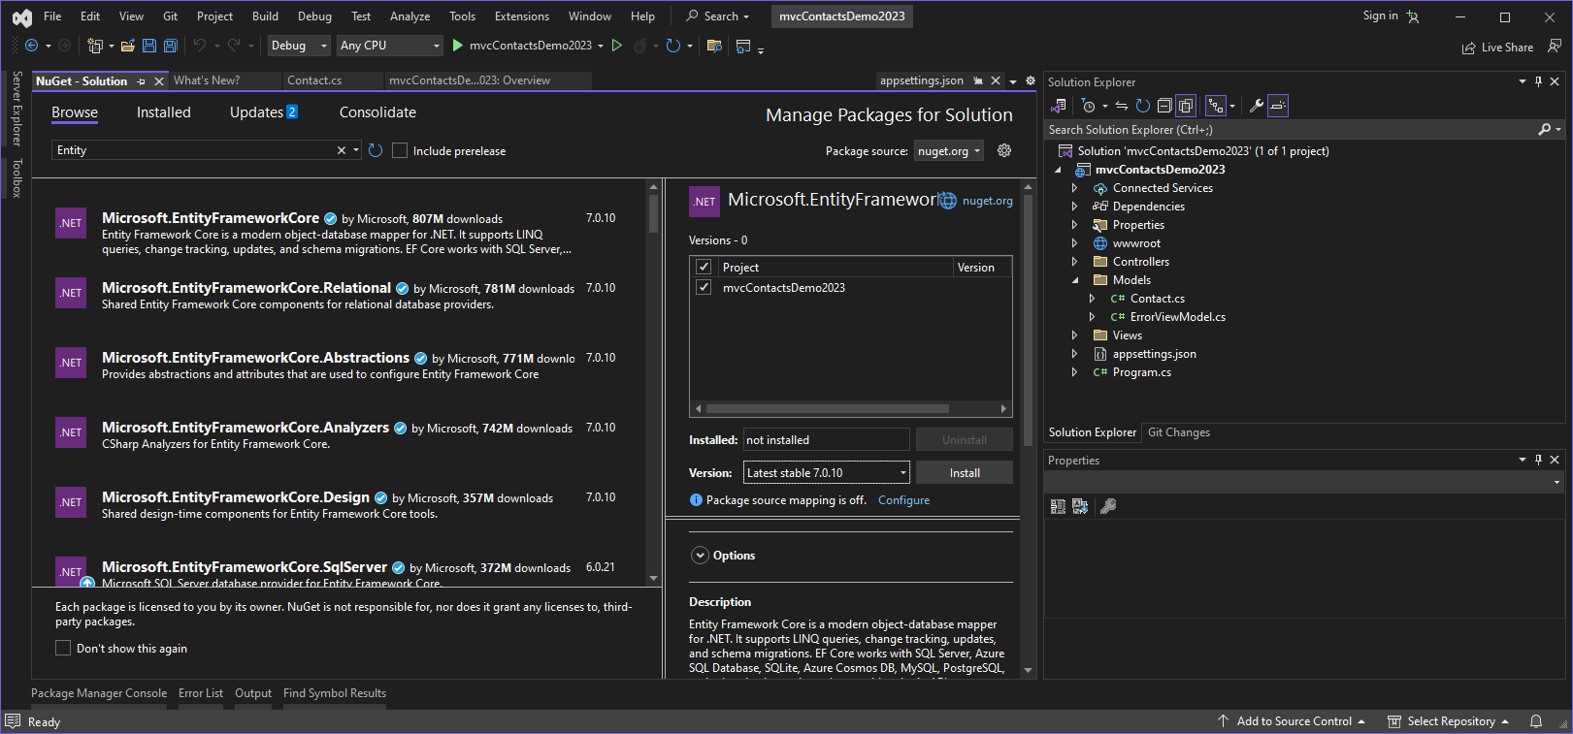
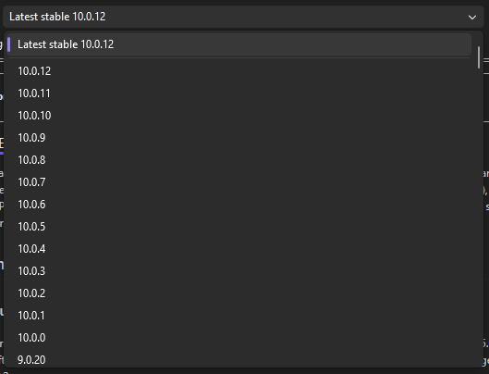
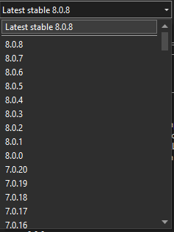
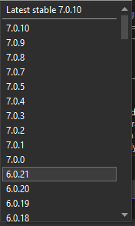
NuGet packages
(choosing the right version)
When installing NuGet packages, be aware that you can choose which version of the package will be installed within your project (and it will always default to the newest version)
This becomes a problem if you mix/match versions across major versions of .NET. Newer packages meant for the latest .NET development will not function correctly with older versions of .NET
Always ensure to choose the latest version of your main version of .NET

Slide 17
Adding Entity Framework Packages
ASP.NET Core Projects require downloading / installing several separate NuGet Packages to provide a complete strategy for working with EF Core:
  Microsoft.EntityFrameworkCore
  Entity Framework Core is a lightweight and extensible version of the popular Entity Framework data access technology.
  Microsoft.EntityFrameworkCore.SqlServer
  Microsoft SQL Server database provider for Entity Framework Core.
  Microsoft.EntityFrameworkCore.Tools
  Entity Framework Core Tools for the NuGet Package Manager Console in Visual Studio:
  Add-Migration Drop-Database Get-DbContext
  Scaffold-DbContext Script-Migrations Update-Database
  NOTE: Ensure that when you install these packages, choose v10.0.12 for ALL Packages
  (ONLY use NuGet packages with the same MAJOR version as .NET : 10.0)
Notes:
If they have never used the Package Manager Console to install packages before, they can try it now:
install-package microsoft.entityframeworkcore -version 3.1.10
install-package microsoft.entityframeworkcore.sqlserver -version 3.1.10
install-package microsoft.entityframeworkcore.tools -version 3.1.10

Slide 18
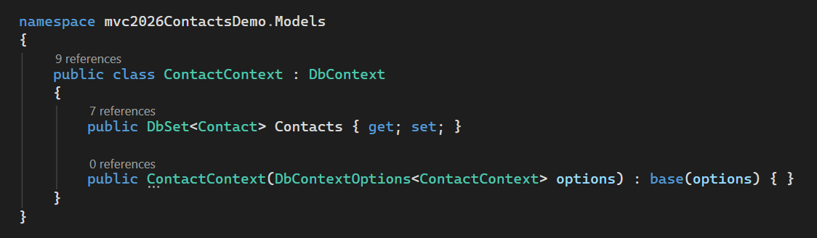
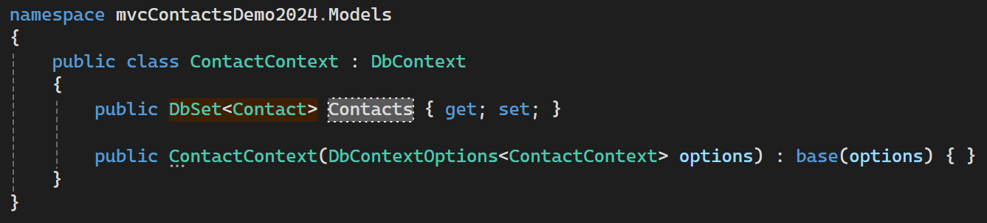

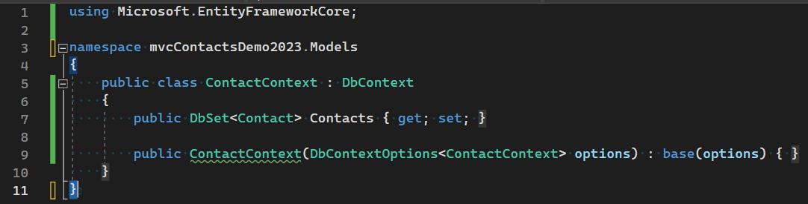
Create a database context
This is our Database Context class – there is no other configuration, special interfaces, etc. needed except the appropriate connectionstring entry and a using statement for Microsoft.EntityFrameworkCore
* By extending the DbContext base class, our DbContext class is able to handle our database operations for us. We need to include DbSet statements for each entity we want to synchronize with our database.

Slide 19
DbContext and DbSet
The DbContext class is from Entity Framework Core. It represents a session with the database and allows us to query and save data.
In our derived context class, we define one or more properties that are a DbSet for every type in our models.
The DbSet allows us to query and save instances of those indicated types.
  The DbSet represents an entity set that is used to perform create, read, update and delete operations

Slide 20
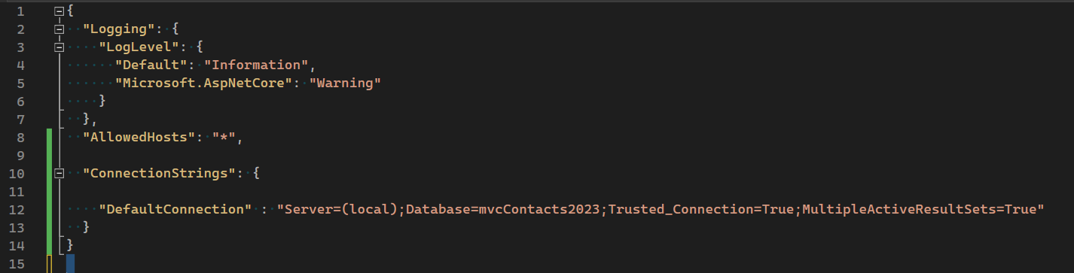
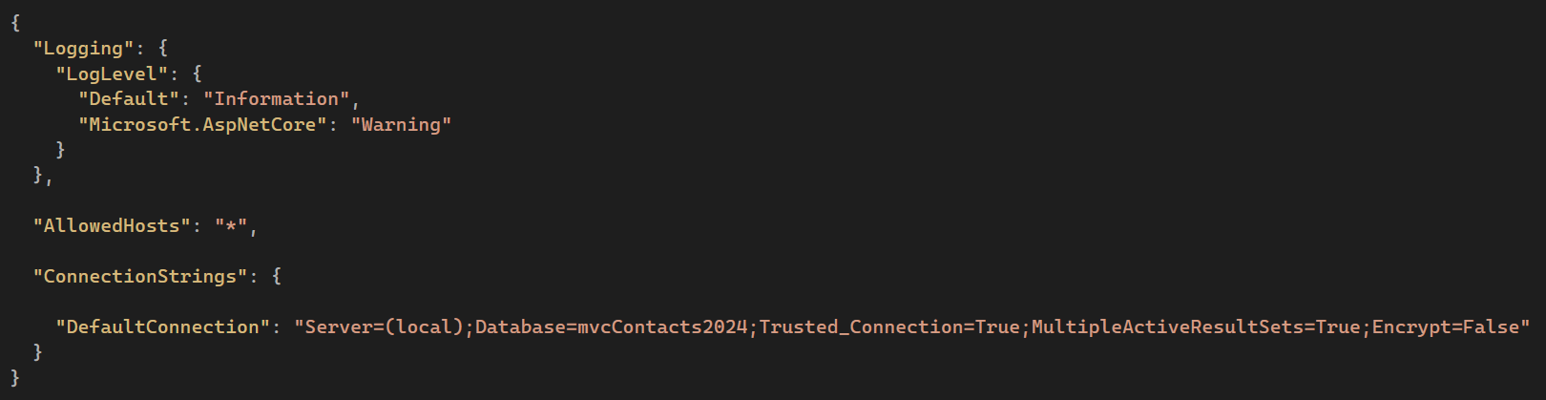
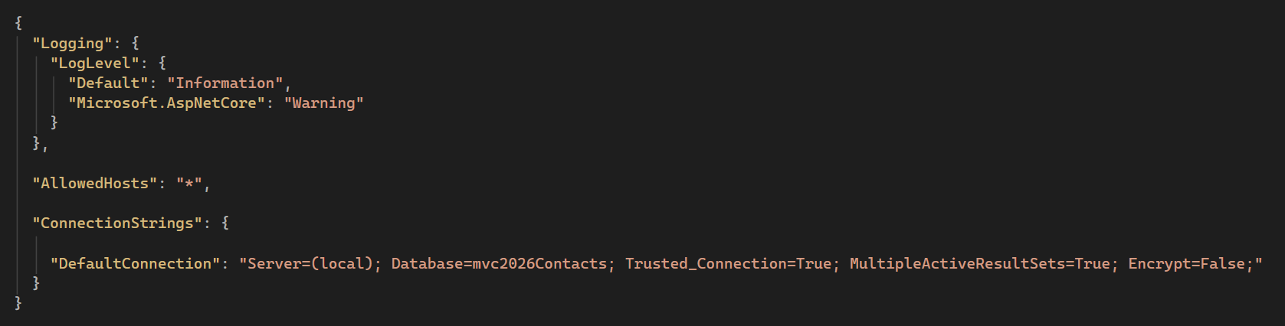
Adding a Connection String
The configuration for making connections to the separate data sources our project utilized is stored within appSettings.json, within the ConnectionStrings area.
Beware: We are not working in XML, but JSON (Java-Script Object Notation)
Each configuration item must be comma separated
Notes:
"ConnectionStrings": {
"DefaultConnection" : "Server=(local);Database=School2DB;Trusted_Connection=True;MultipleActiveResultSets=true"
}

Slide 21
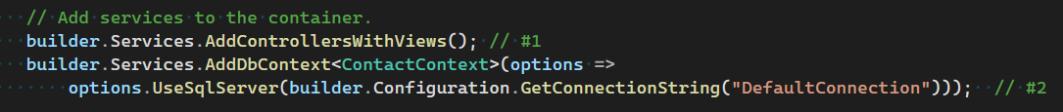
Configuring the Services for ASP.NET CORE
Program.CS is responsible for configuring many of the Project-wide settings, including:
  Which features of ASP.NET Core will be activated for your specific project
  Project Routing options
  Several of the Services we require to be configured are:
    Support for MVC Controllers/Views (using Razer HTML)
    Adding a DbContext for the project (using the ConnectionString we created)
    NOTE: Services have an order of initialization for correct behaviour. Do not modify the ordering from the example provided.

Slide 22
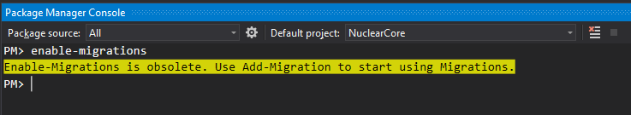
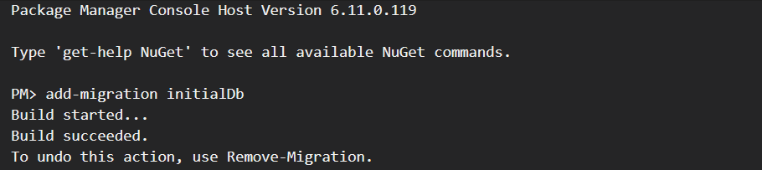
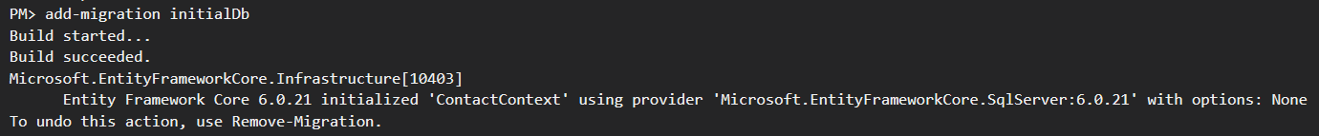
Creating the Initial EF Core Migration
The structure of a database generated using Entity Framework using Code-First approach is accomplished by the creation of migrations.
Migrations are enabled by default once we have installed the Entity Framework Core packages within our project. We only require the use of add-migration <migrationname> and update-database for updating / deploying our ORM to the Database (using the Context/Connection String we previously added)
NOTE: We also have access to Remove-Migration to easily delete (undeployed) migrations from our project
Notes:
We now have the addition of Remove-Migration to

Slide 23
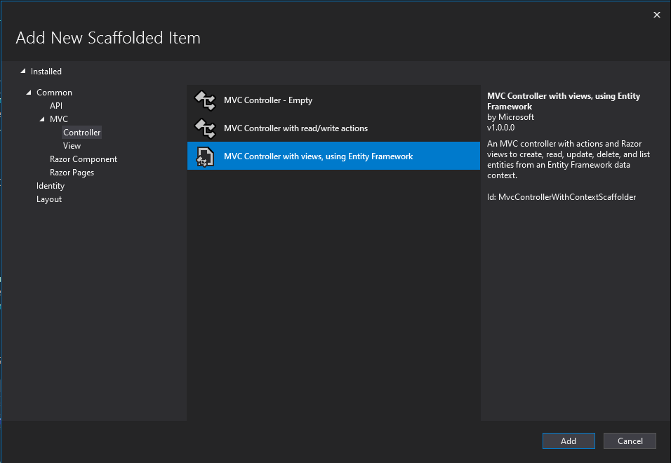
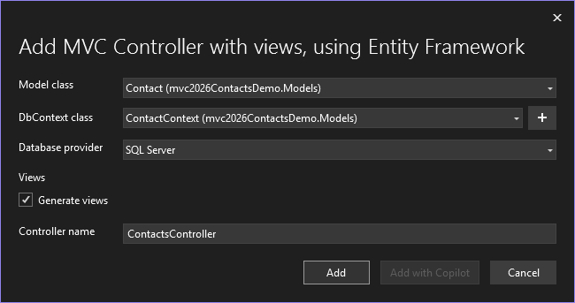
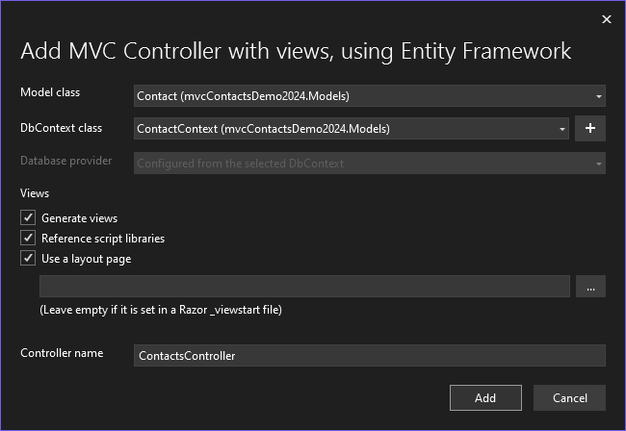
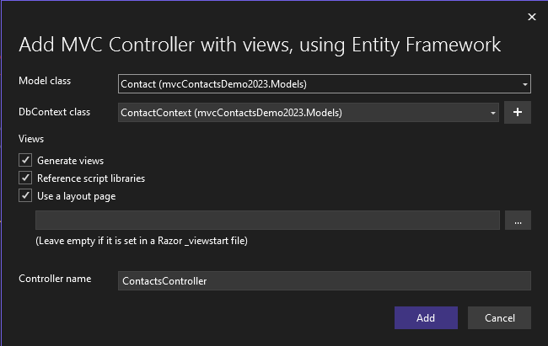
Generate Controller(s) / Views for EF Model
When we choose to create a new controller within our project, we can select an MVC Controller with views using Entity Framework.
All we need do is select the Model class from our project we wish to scaffold the Controller/Views for, as well as the DBContext class that will be used for data access (and choose a Controller name)

